Slide 1

Software Design and Arcitecture(SDA) Lecture 4
Engr.Ramsha Mashood
Senior Lecturer
Department of Software Engineering
Bahria University Karachi Campus

Slide 2




Functional Design; UI Design; Web Applications Design

Slide 3

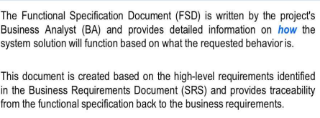
Functional DESIGN

Slide 4
User interface design
User interface (UI) design is the process designers use to build interfaces in software or computerized devices, focusing on looks or style. Designers aim to create interfaces which users find easy to use and pleasurable. UI design refers to graphical user interfaces and other forms—e.g., voice-controlled interfaces.

Slide 5
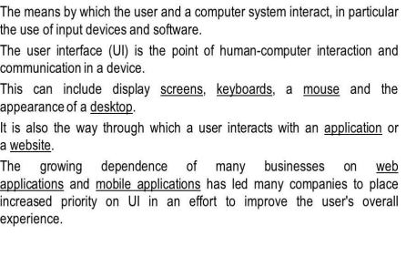
User interface design

Slide 6
Types of user interface
Command-Line Interface (CLI)
Natural Language
Graphical User Interface (GUI)
Touch-Based Interface
Voice User Interface (VUI)
Augmented Reality (AR) and Virtual Reality (VR) Interfaces
Form based Interface

Slide 7
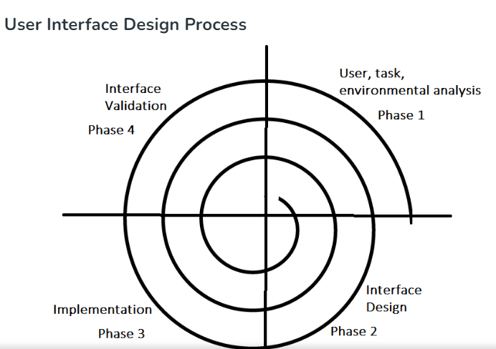

Slide 8
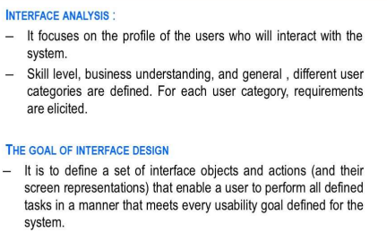
User interface 4 distinct framework

Slide 9
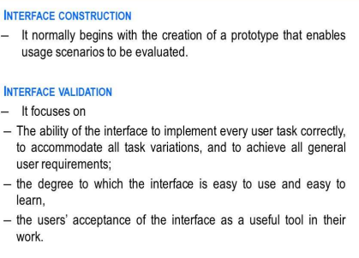
User interface 4 distinct framework

Slide 10
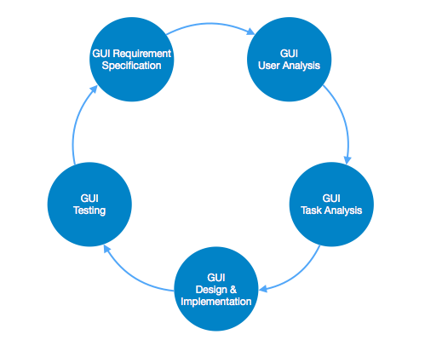
User interface design activities

Slide 11
Description
GUI Requirement Gathering -
The designers may like to have list of all functional and non-functional requirements of GUI.
This can be taken from user and their existing software solution..

Slide 12
Description
User Analysis - The designer studies who is going to use the software GUI. The target audience matters as the design details change according to the knowledge and competency level of the user. If user is technical savvy, advanced and complex GUI can be incorporated. For a novice user, more information is included on how-to of software.

Slide 13
Description
Task Analysis -
Designers have to analyze what task is to be done by the software solution. Here in GUI, it does not matter how it will be done.
Tasks can be represented in hierarchical manner taking one major task and dividing it further into smaller sub-tasks.
Tasks provide goals for GUI presentation.
Flow of information among sub-tasks determines the flow of GUI contents in the software.

Slide 14
Description
GUI Design & implementation -
Designers after having information about requirements, tasks and user environment, design the GUI and implements into code and embed the GUI with working or dummy software in the background.
It is then self-tested by the developers.

Slide 15
Description
Testing - GUI testing can be done in various ways.
Organization can have in-house inspection;
direct involvement of users and release of beta version are few of them.
Testing may include usability, compatibility, user acceptance etc.

Slide 16
User Interface design patterns
User interface (UI) design patterns are reusable/recurring components which designers use to solve common problems in user interface design.
UI design patterns serve as design blueprints that allow designers to choose the best and most used interfaces for the user's specific context.

Slide 17
User Interface design patterns
A user’s usability-related problem.
The context/situation where that problem happens.
The principle involved—e.g., error management.
The proven solution for the designer to implement to address the core of the problem.
Why—the reason for the pattern’s existence and how it can affect usability.
Examples—which show the pattern’s successful real-life application (e.g., screenshots and descriptions).
Implementation—some patterns include detailed instructions.

Slide 18
What is web application
A web application (web app) is an application program that is stored on a remote server and delivered over the internet through a browser interface.
Web services are web apps by definition and many, although not all, websites contain web apps.
Developers design web applications for a wide variety of uses and users, from an organization to an individual for numerous reasons. Commonly used web applications can include webmail, online calculators or e-commerce shops. While users can only access some web apps by a specific browser, most are available no matter the browser.

Slide 19
difference
Think of the main differences this way: a website displays information and content to visitors and usually stays the same and static.
But a web app both displays information and allows users to interact dynamically. Programming-wise, websites are mainly made with HTML or CSS, while web apps can be made with a plethora of programming languages."

Slide 20
types
Types of web applications ➤ Static web application ➤ Dynamic web application ➤ E-commerce web application ➤ Content management system web application ➤ Single-page web application ➤ Multiple-pages web application ➤ Portal web application ➤ Animated web application ➤ Rich internet web application ➤ Progressive web application

Slide 21
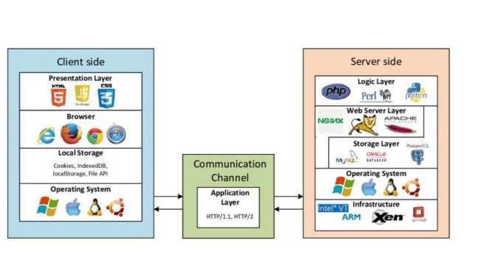
Web app

Slide 22
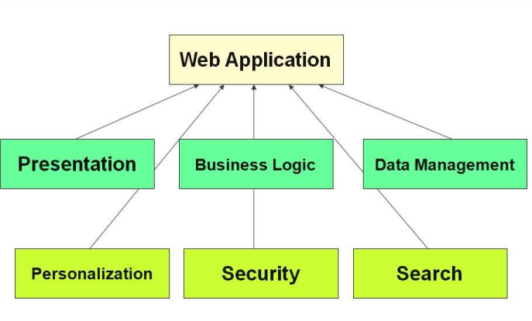
Web app

Slide 23
Some Links
https://ui-patterns.com/patterns

Slide 24
Continue….
Any thing to ask ??

